Slide 1
Internship Project:
Monitoring Rapid Temperature Cycle in Liquid
05 April 2023
PT TDK ELECTRONICS INDONESIA
TPS Business Group • BT TPS HR
Batam, Indonesia

Slide 2
Project Team
I Made Aditya Rama P
Internship Politeknik Elektronika Negeri Surabaya - NIM: 4120600021
Major - Mechatronics Engineering
Sander Antonius Balisa Internship Politeknik Elektronika Negeri Surabaya - NIM: 2120600053 Major – Electronic Engineering
Project Mentor
Head of department : Mr. Mahesh Nair
Mentor : Mr. Syaifudin Muchlis
Project supervisor : Mr. Indratno Sukmandaru

Slide 3

Project Objectives :
The purpose of this project is to implement industrial revolution 4.0 digitalization for RTC (Rapid Temperature Cycling in Liquids) system. This project is an improvement project compared existing system.

Slide 4
List of project benefits:
Categories | Existing System | Improvement Project
Capabilities | Up to 195 samples | Up to 3120 samples
DMM Connections | 1 DMM | Up to 16 DMM
Real-time Graph | No | Yes
Output | Text File (*.txt) | Excel File (*.xlsx) + Table Format View + Auto Graph
Bath Temperature Monitoring | No | Yes
Auto Chart Export | No (just file .txt) | Yes (Auto Create Chart and Box and Whisker)

Slide 5
List of project benefits:
Categories | Existing System | Improvement Project
Data Storage | Text File (*.txt) | SQL Server Database
Sampling Schedule | Static | Dynamic
Output | Text File (*.txt) | Excel File (*.xlsx) + Table Format View + Auto Graph
GUI | Static | Dynamic (Customizable)
Alarm Alert | No | Yes
Email Notification | No | Yes
Hardware Settings | Non-Configurable | Configurable

Slide 6
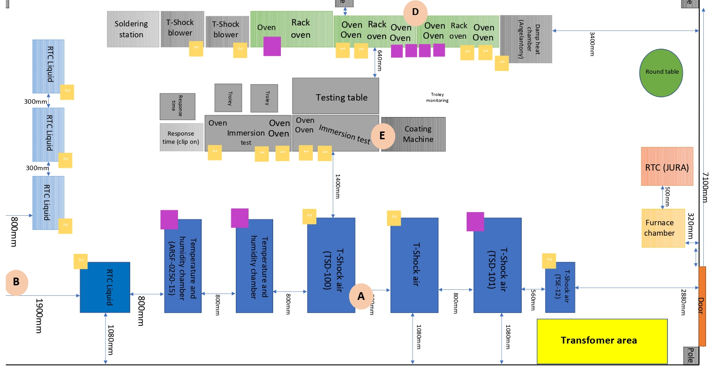
Machine layout
Monitoring Area

Slide 7
Requirement
Hardware
No | Name | Brand / Type | Qty | Unit
1 | Module for thermocouple (8 thermocouple) | Advantech | 1 | Pcs
2 | Thermocouple type-K |  | 6 | Pcs
3 | Digital Multi meter Module | Keithley | 1 | Pcs
4 | Digital Multi meter |  | 1 | Pcs
4 | GPIB Cable |  | 1 | Pcs
5 | Personal Computer |  | 1 | Pcs

Slide 8
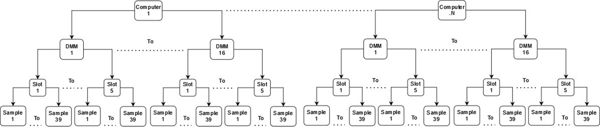
Maximum collected samples
39 samples x 5 slots x 16 DMM = 3.120 samples
And more N computer….

Slide 9
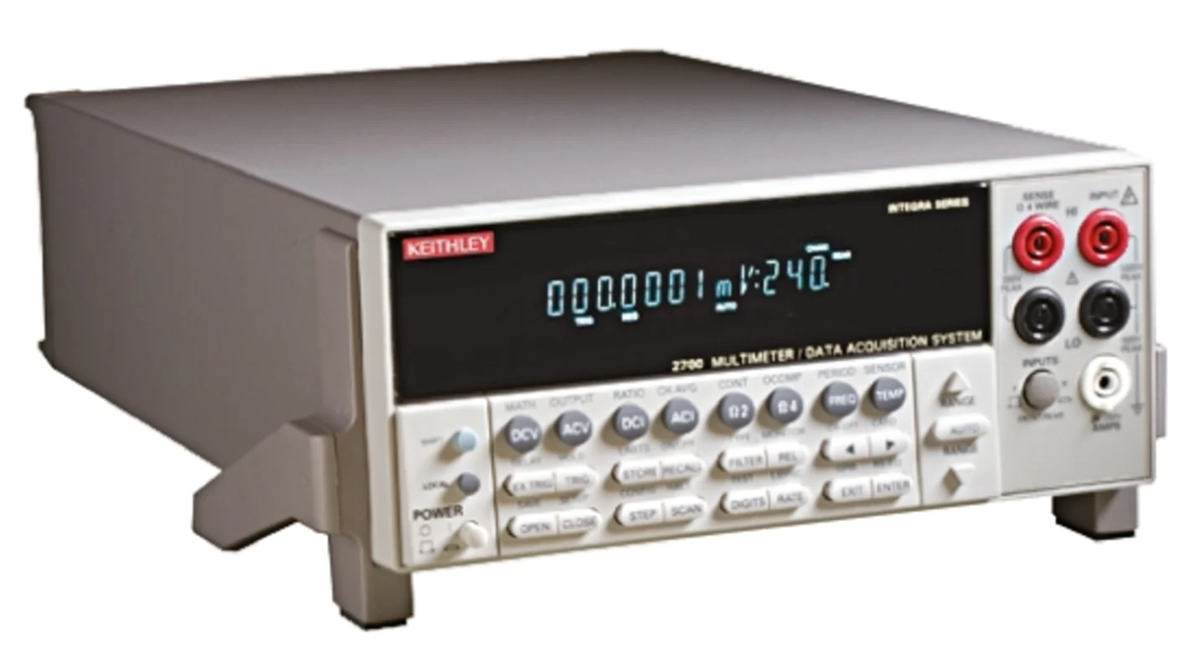
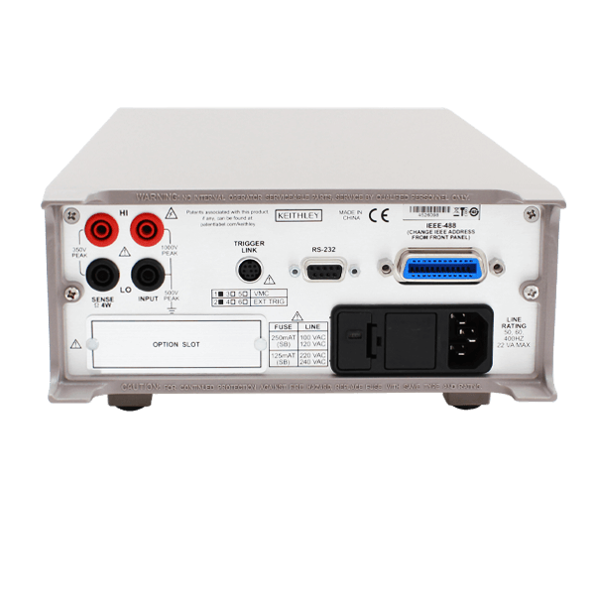
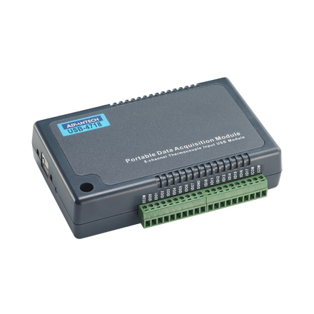
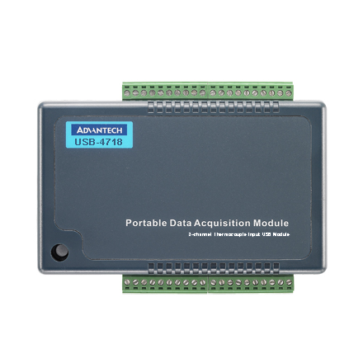
Hardware Components
Front
Back
A Digital Multi mater module used for data acquisition, switching ,data logging, for sampling data on sensor
Front
Back
A thermocouple module used for reading data analog on sensor and convert to digital such as temperature.

Slide 10
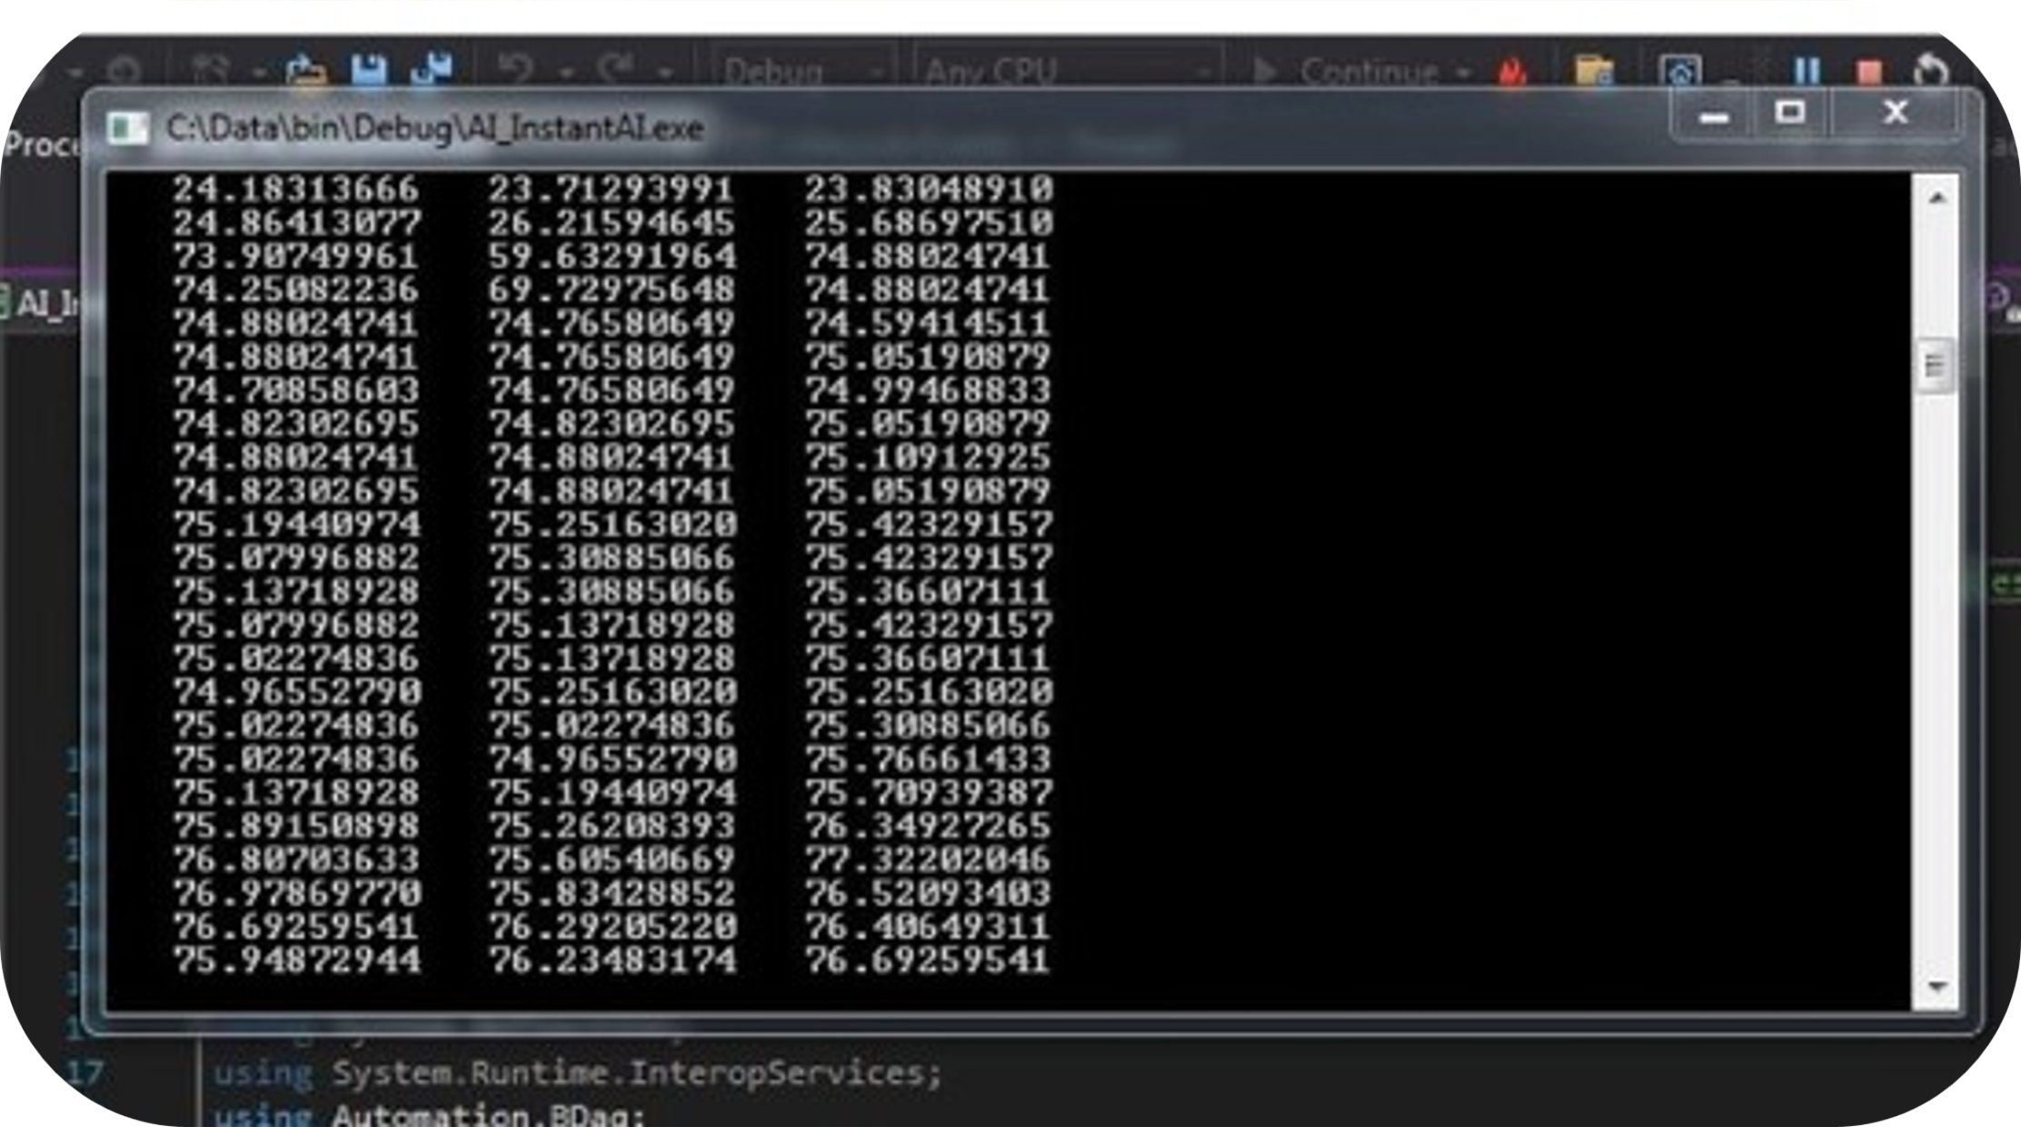
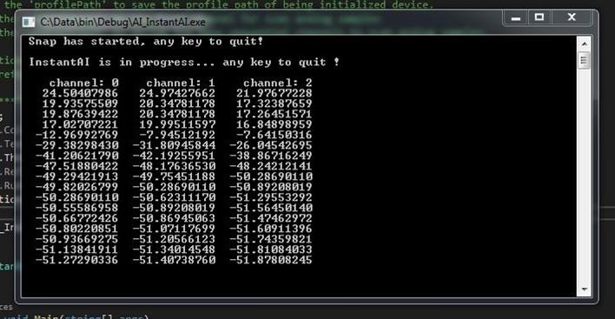
Thermocouple Module for Data Collection
Hot Temperature bath
Cold Temperature bath

Slide 11
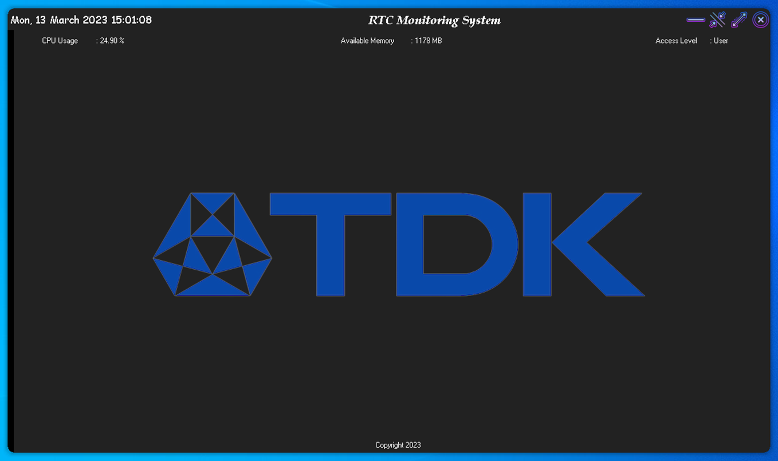
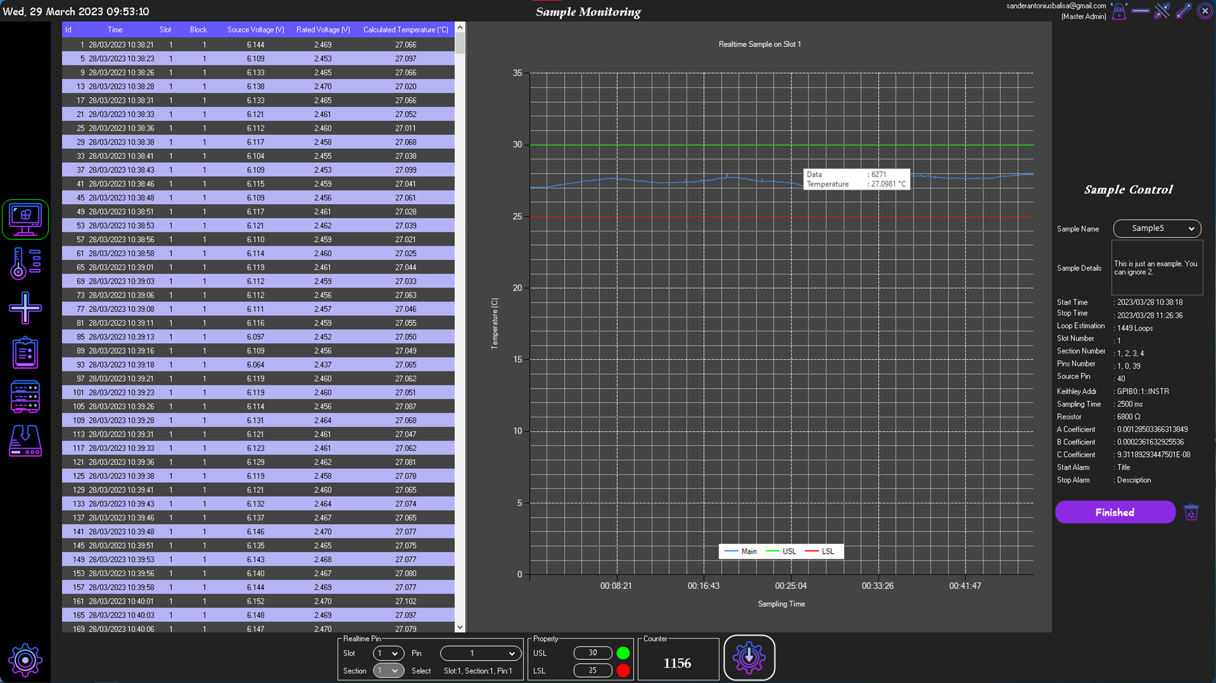
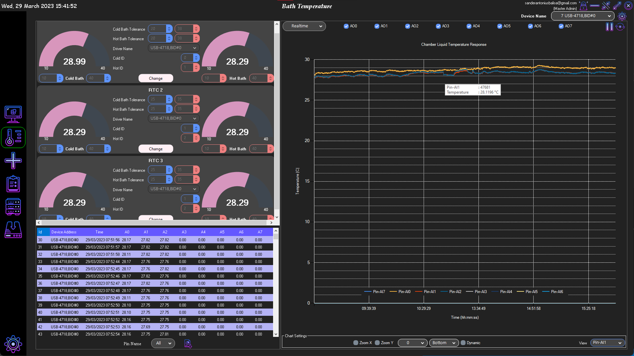
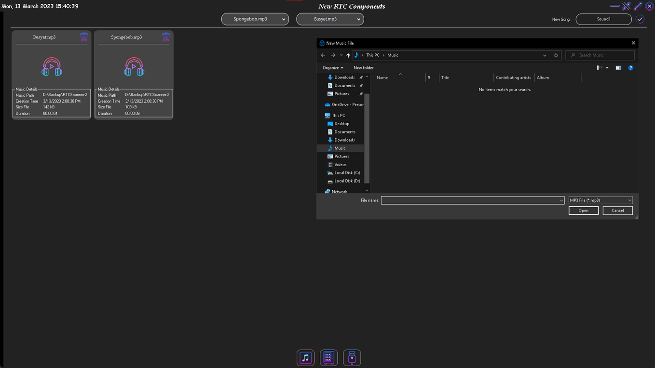
1. Welcome screen
Application User interface
2. Voltage Realtime Monitoring
3. Temperature Realtime Monitoring
4. Alarm Options

Slide 12
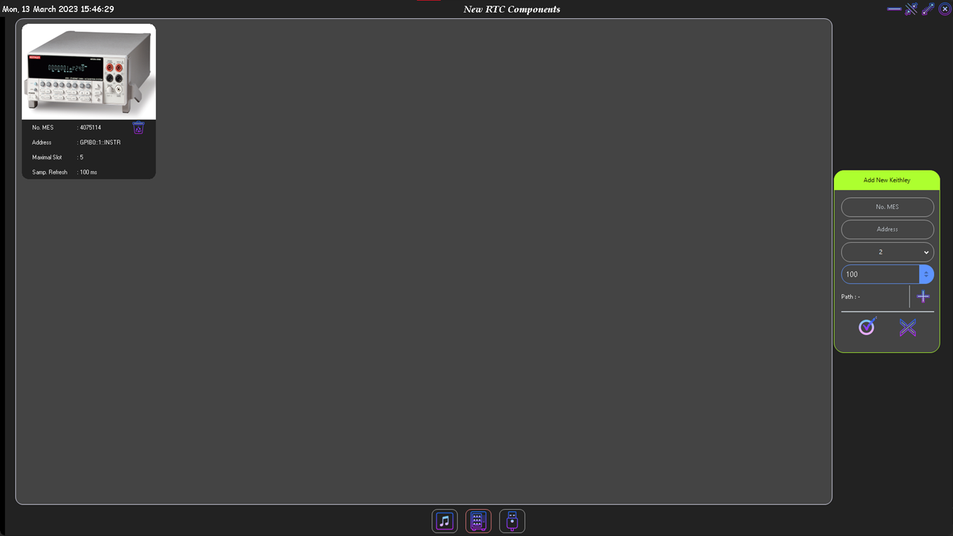
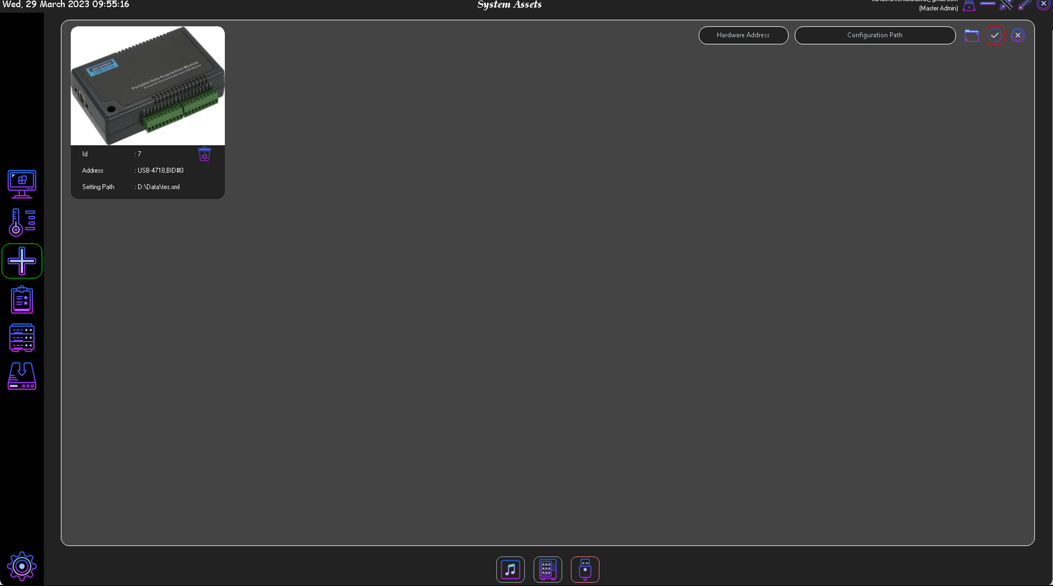
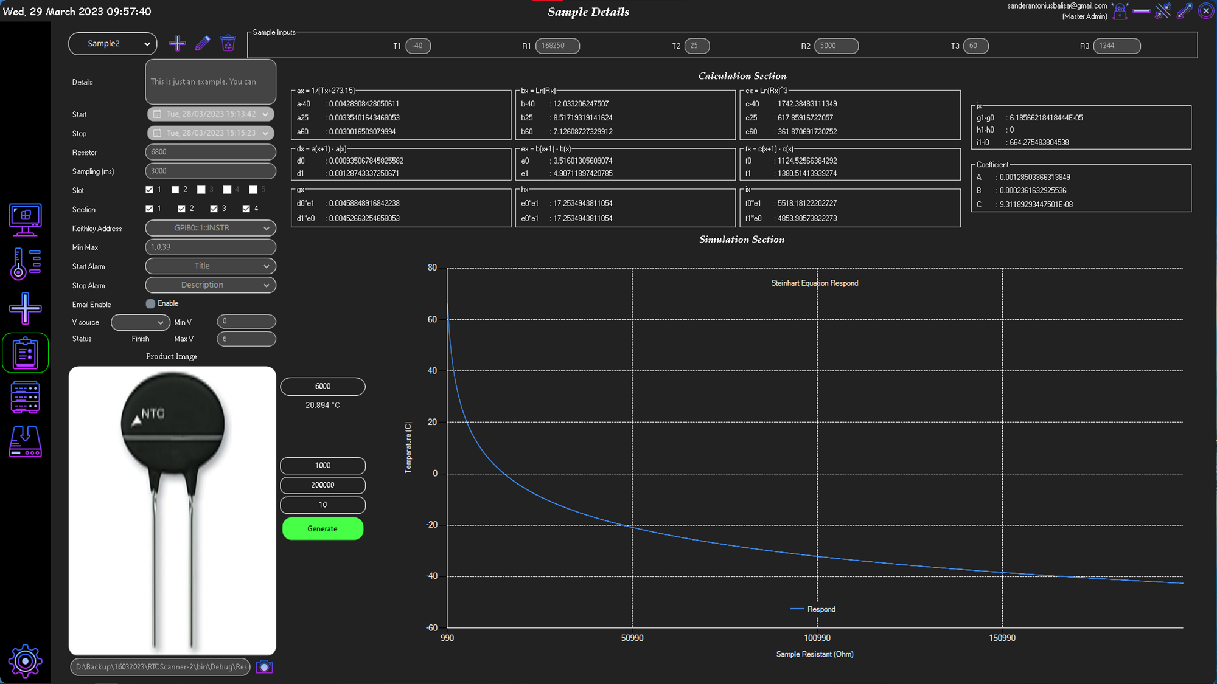
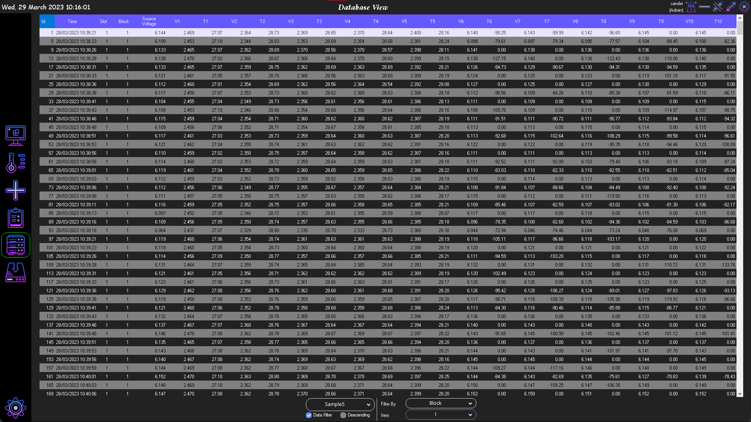
5. Assets Menu
Application User interface
6. Assets Thermocouple
7. Menu Equation
8. Database View

Slide 13
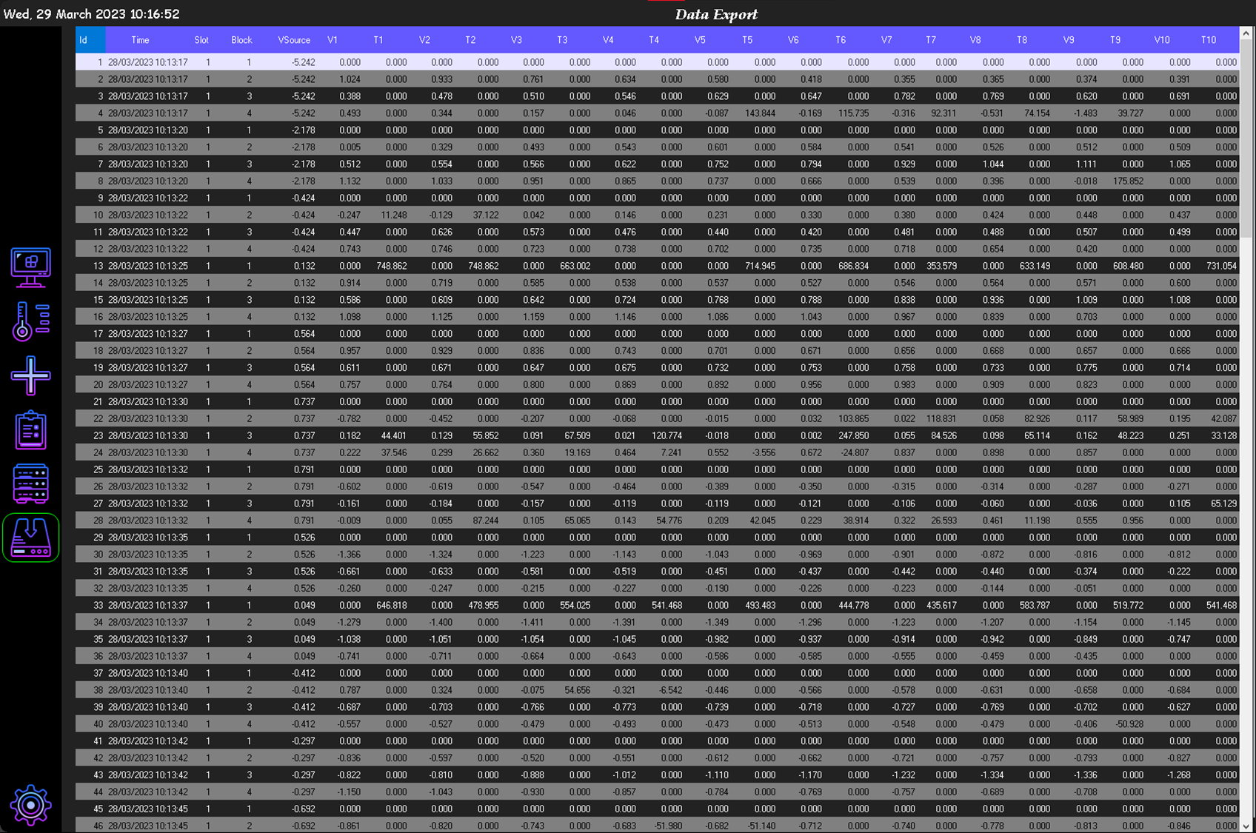
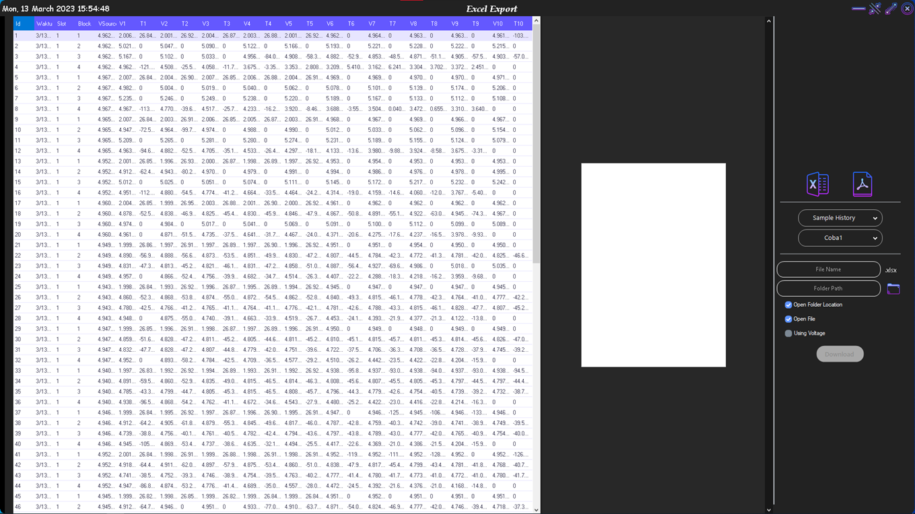
9. Export Menu
Application User interface
Data view before exporting
Export option setting type file (*.xlsx) or pdf, and setting the saving directory.

Slide 14
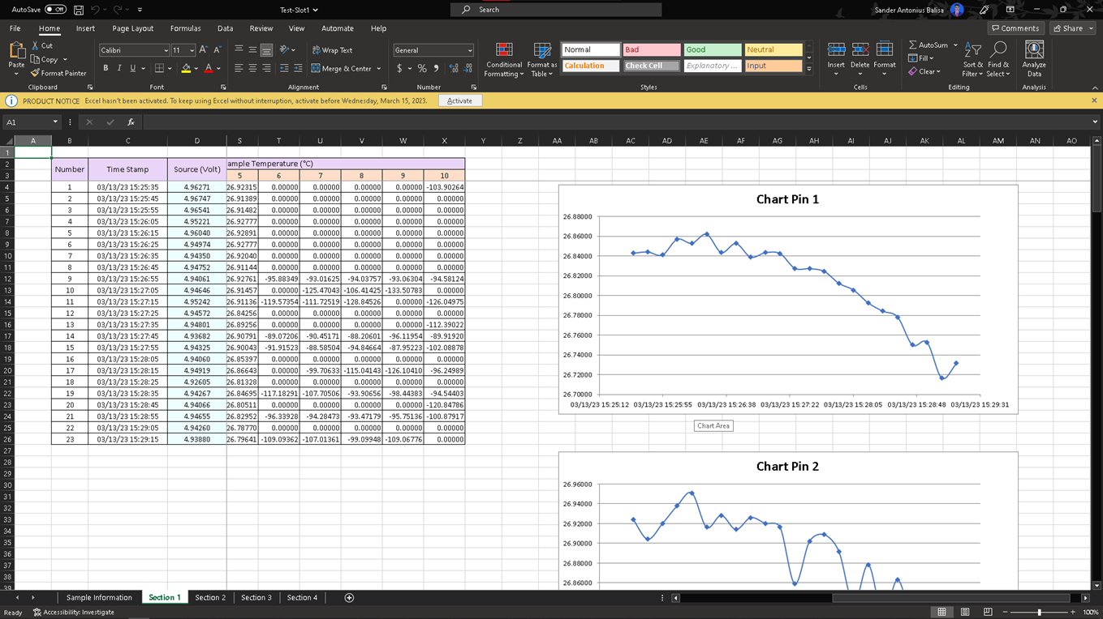
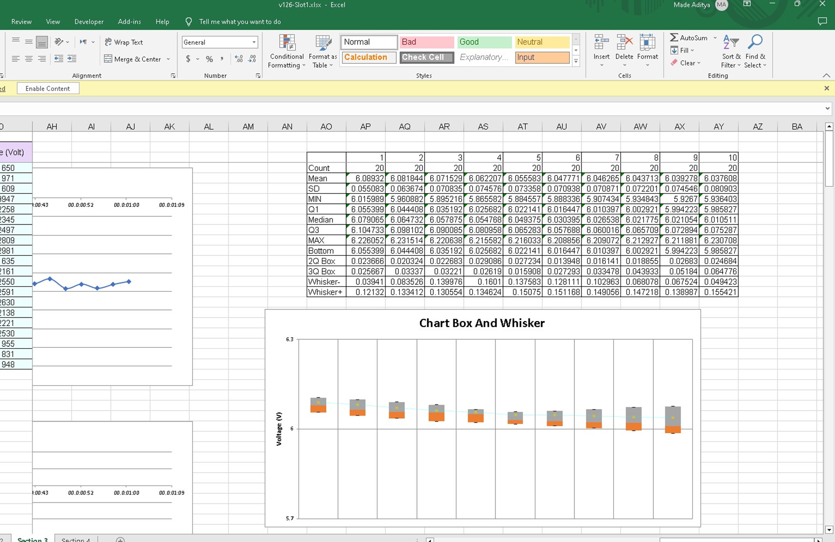
10. View data result in excel
Application User interface
View Data and auto create Chart
Data Report by Chart Box and Whisker

Slide 15
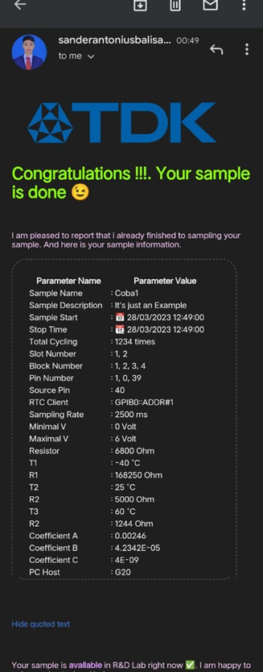
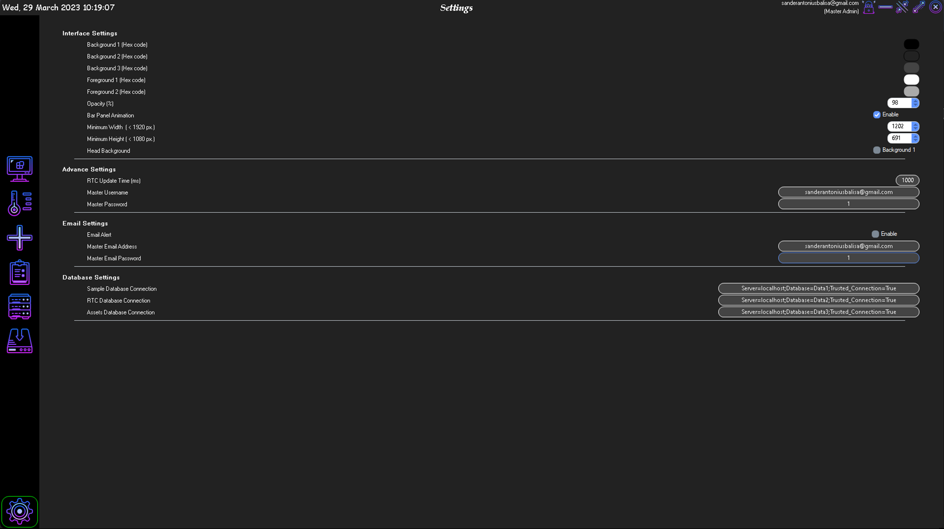
11. Change User Interface color setting
Application User interface
Information about samples

Slide 16
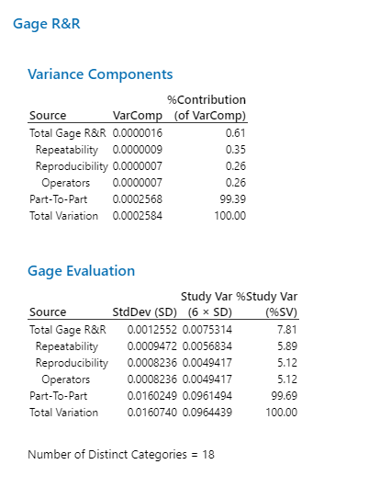
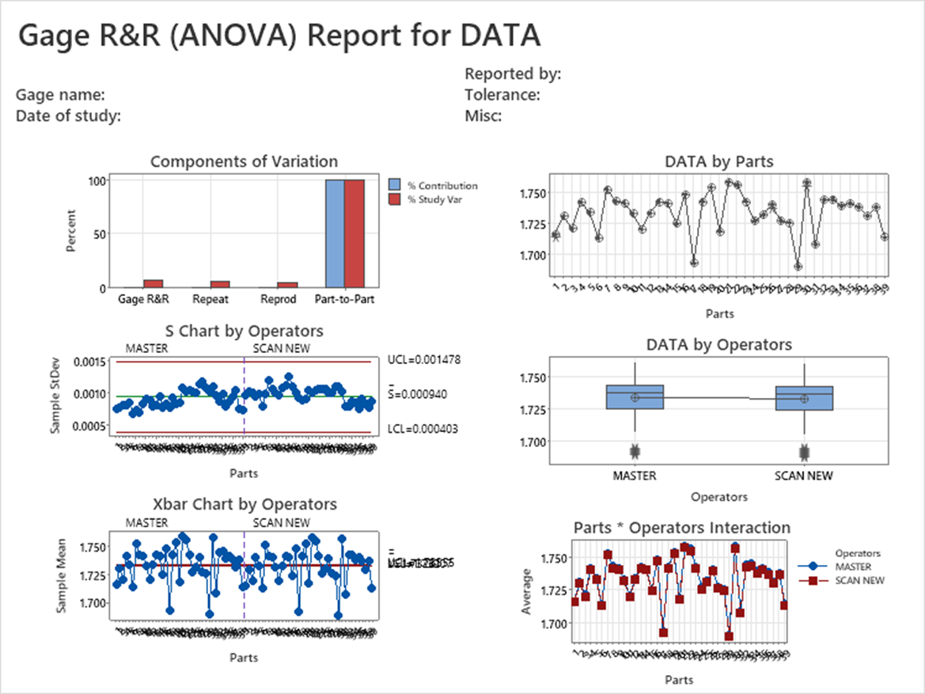
Result Gage R&R Study - ANOVA Method
Data Analytics

Slide 17
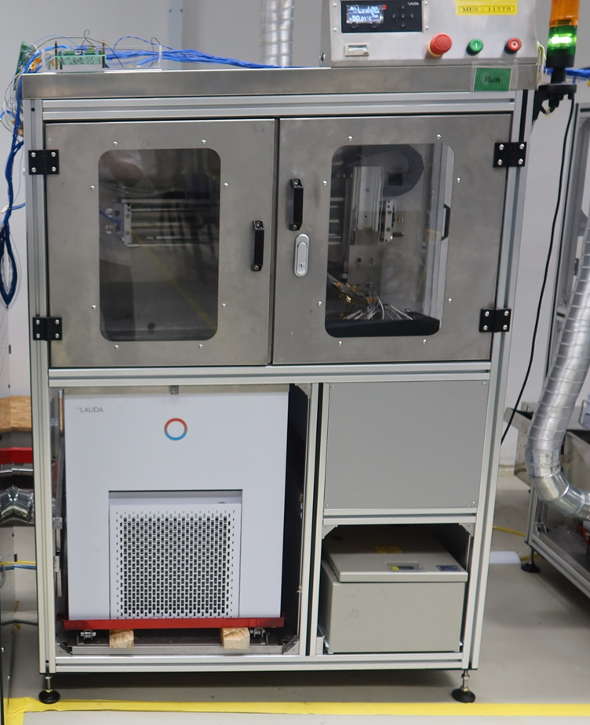
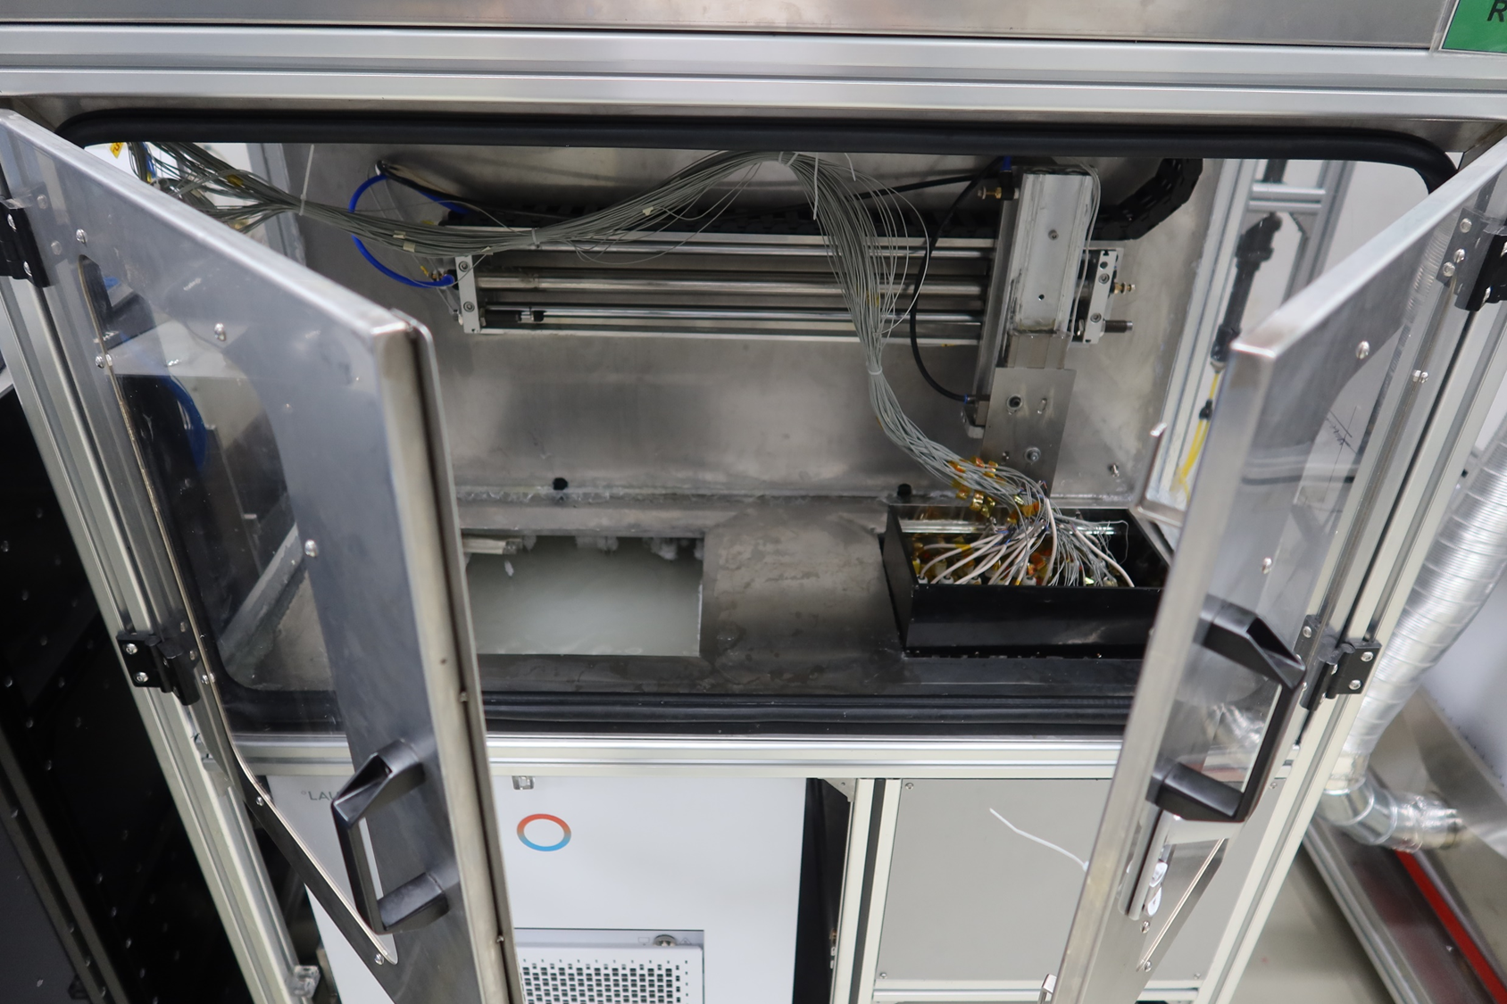
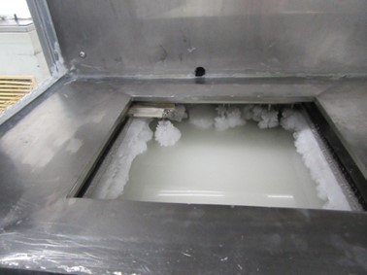
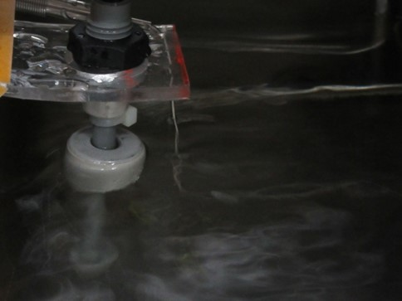
Installation
Hardware
View of RTC machine on front
Thermocouple
Thermocouple
View in RTC within Cold Temperature
View in RTC with Hot Temperature
View of RTC machine between bath

Slide 18
Conclusion
Monitoring RTC (Rapid Temperature Cycling) Liquid in the
Research and Development Lab
Monitoring Temperature in real-time.
Graphical monitoring of the temperature.
Feature :
Sample Acquisition Data
Bath Temperature Monitoring
Auto create tables and graphs in excel file (*.xlsx).
Alarm System
Email Notification

